Slide 1
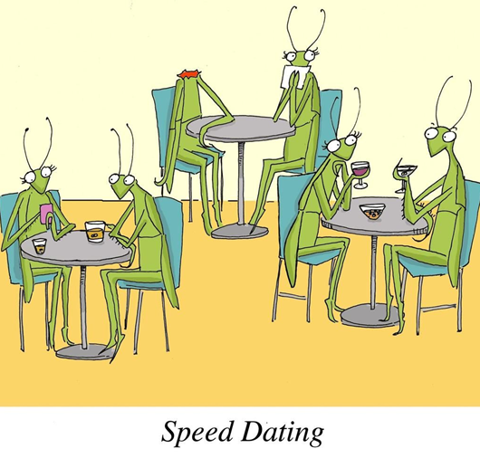
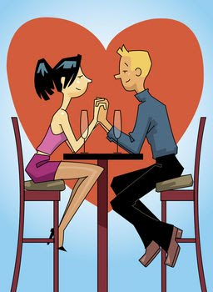
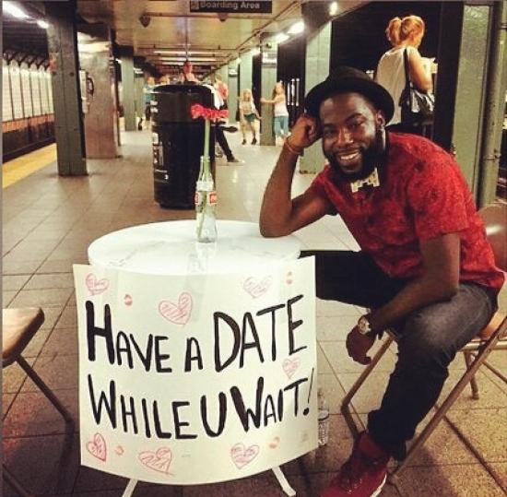
Speed Dating Experiment
Dating Data Wizards
Yan Yu
Tianyi (Jocelyn) Tan
Zehua (KC) Li
Jessica Izquierdo
Areli Rios-Hanhan
DSC 465 - Fall

Slide 2
Agenda
Speed dating experiment overview
Findings on Ethnicity and Dating
Which city has the most successful dates?
Do we Overestimate our Attributes?
Interesting Patterns of Demographics, Self-perception and Dating Success
Questions?

Slide 3
Speed Dating Experiment
Data gathered from speed dating events from 2002 - 2004
552 participants
4 minute dates with opposite sex
Questionnaire about general beliefs and preferences was collected from each person
Each person was asked to rank themselves on different attributes, and after each round, participants were asked to rank their date as well
Matches were generated based on interactions
https://www.kaggle.com/annavictoria/speed-dating-experiment
Notes:
What makes people attractive? What gets people a second date? Why isn't garlic breath a variable in this dataset?
We're about to find out. (Hang in there, single people!)
About the data:
Data was gathered from 552 participants in experimental speed dating events from 2002-2004.
During the events, the attendees would have a four minute "first date" with every other participant of the opposite sex.
At the end of their four minutes, participants were asked if they would like to see their date again. They were also asked to rate their date on six attributes:
Attractiveness
Sincerity
Intelligence
Fun
Ambition
Shared Interests.
The dataset also includes questionnaire data gathered from participants at different points in the process. These fields include:
demographics
dating habits
self-perception across key attributes
beliefs on what others find valuable in a mate
lifestyle information

Slide 4
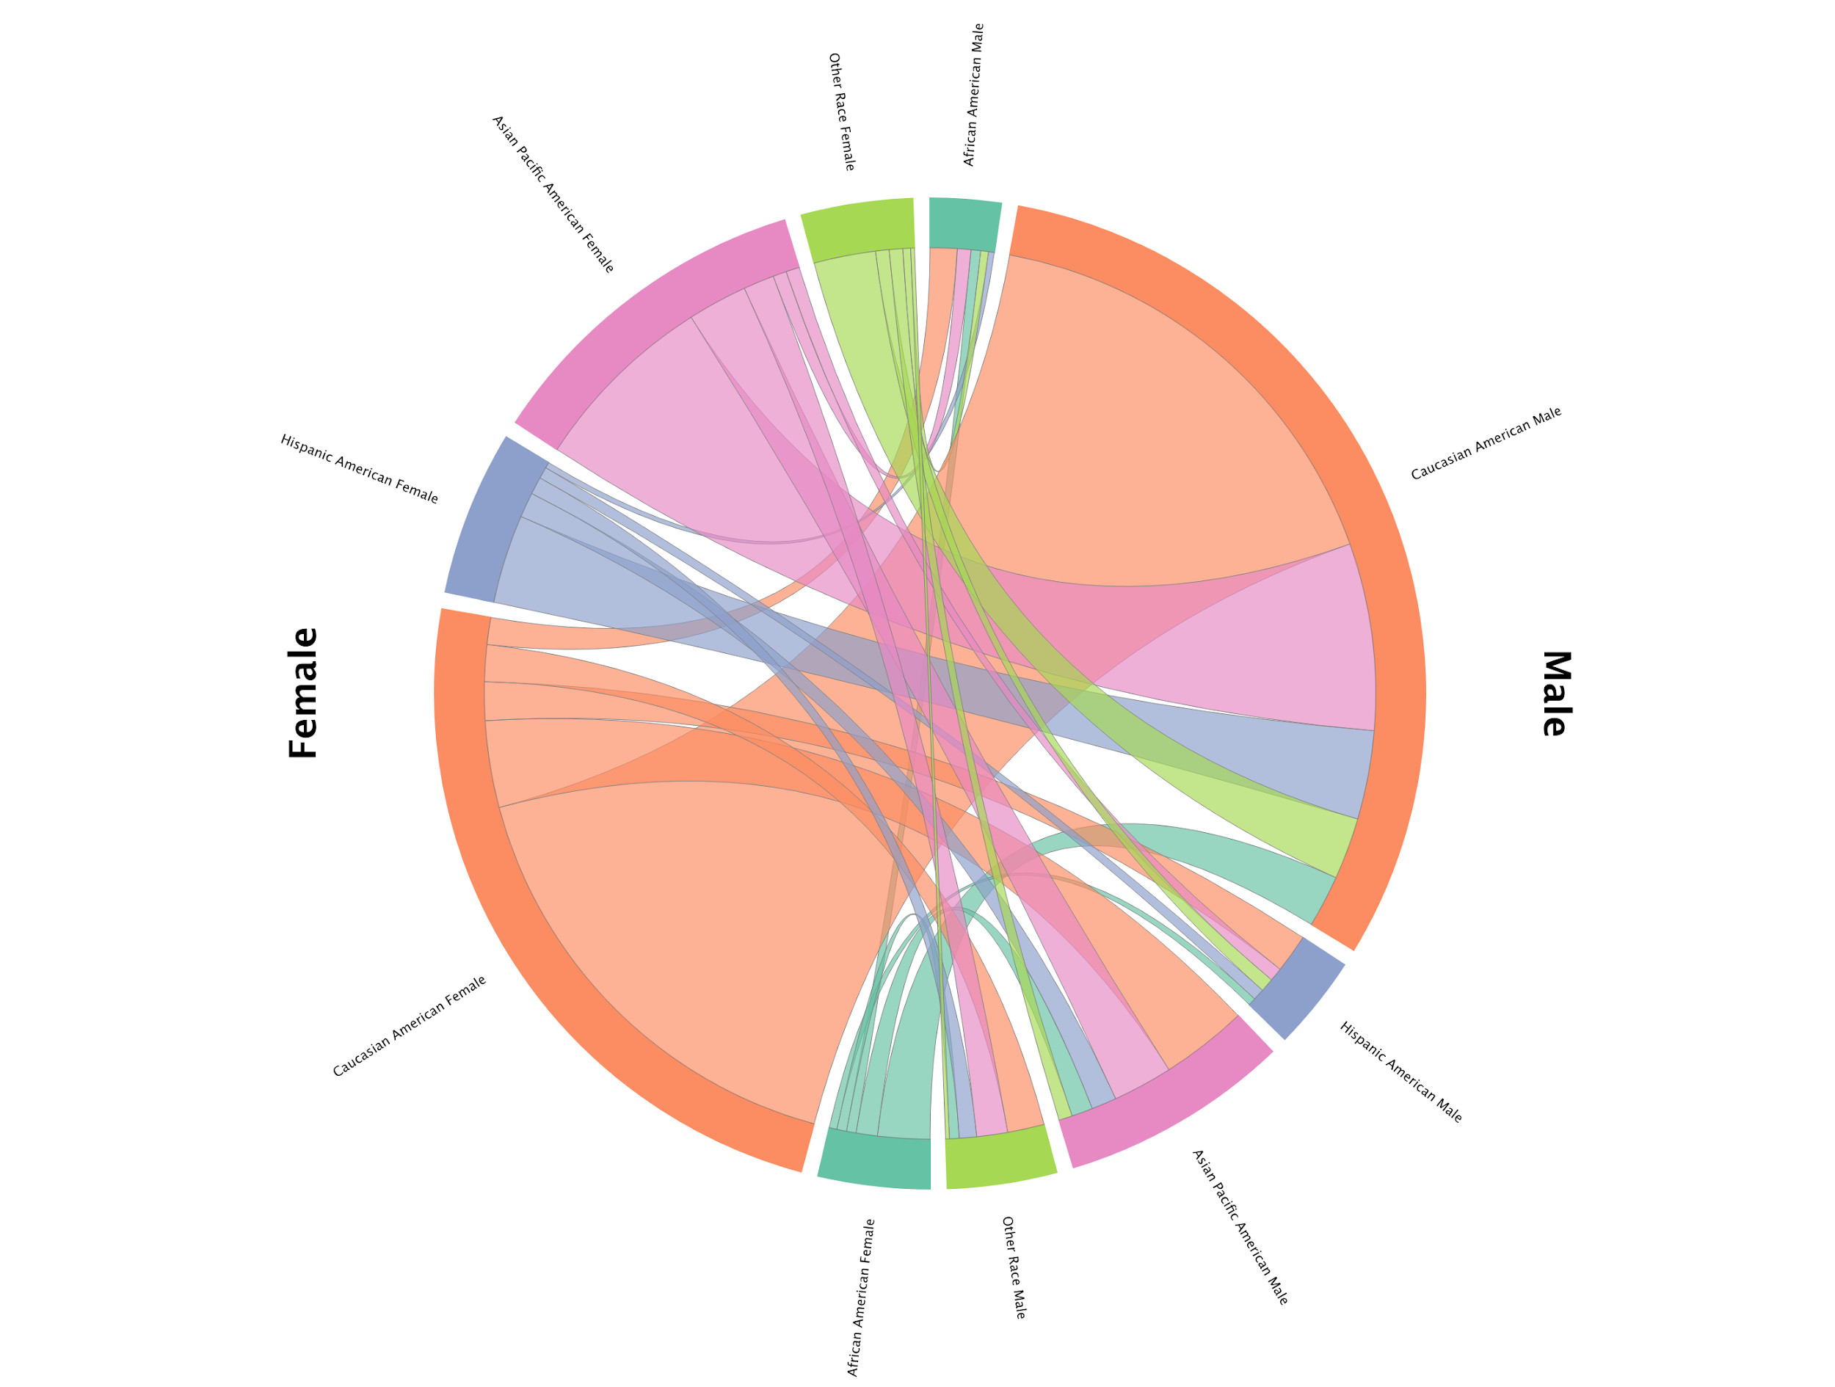
Does Ethnicity influence a Match?
Data displayed in a Network Graph
676 Successful matches
Largest match between Caucasian Males and Caucasian Females.
Second largest match between Asian Pacific Females and Caucasian Males
Notes:
The interactive network graph shows racial composition of 676 successful matches. The most obvious and largest match is between Causation males and Caucasian females (239). The second largest match is between Asian Pacific females and Caucasian males (97). When looking at the male side, the majority of the matches for each ethnic group resides with Caucasian females, followed by Asian Pacific females. When looking at the female side, the majority of the matches for each ethnic group resides with Caucasian males, followed by Asian Pacific males (exception: the second largest racial demographic of Other Race females goes to Hispanic American males).

Slide 5
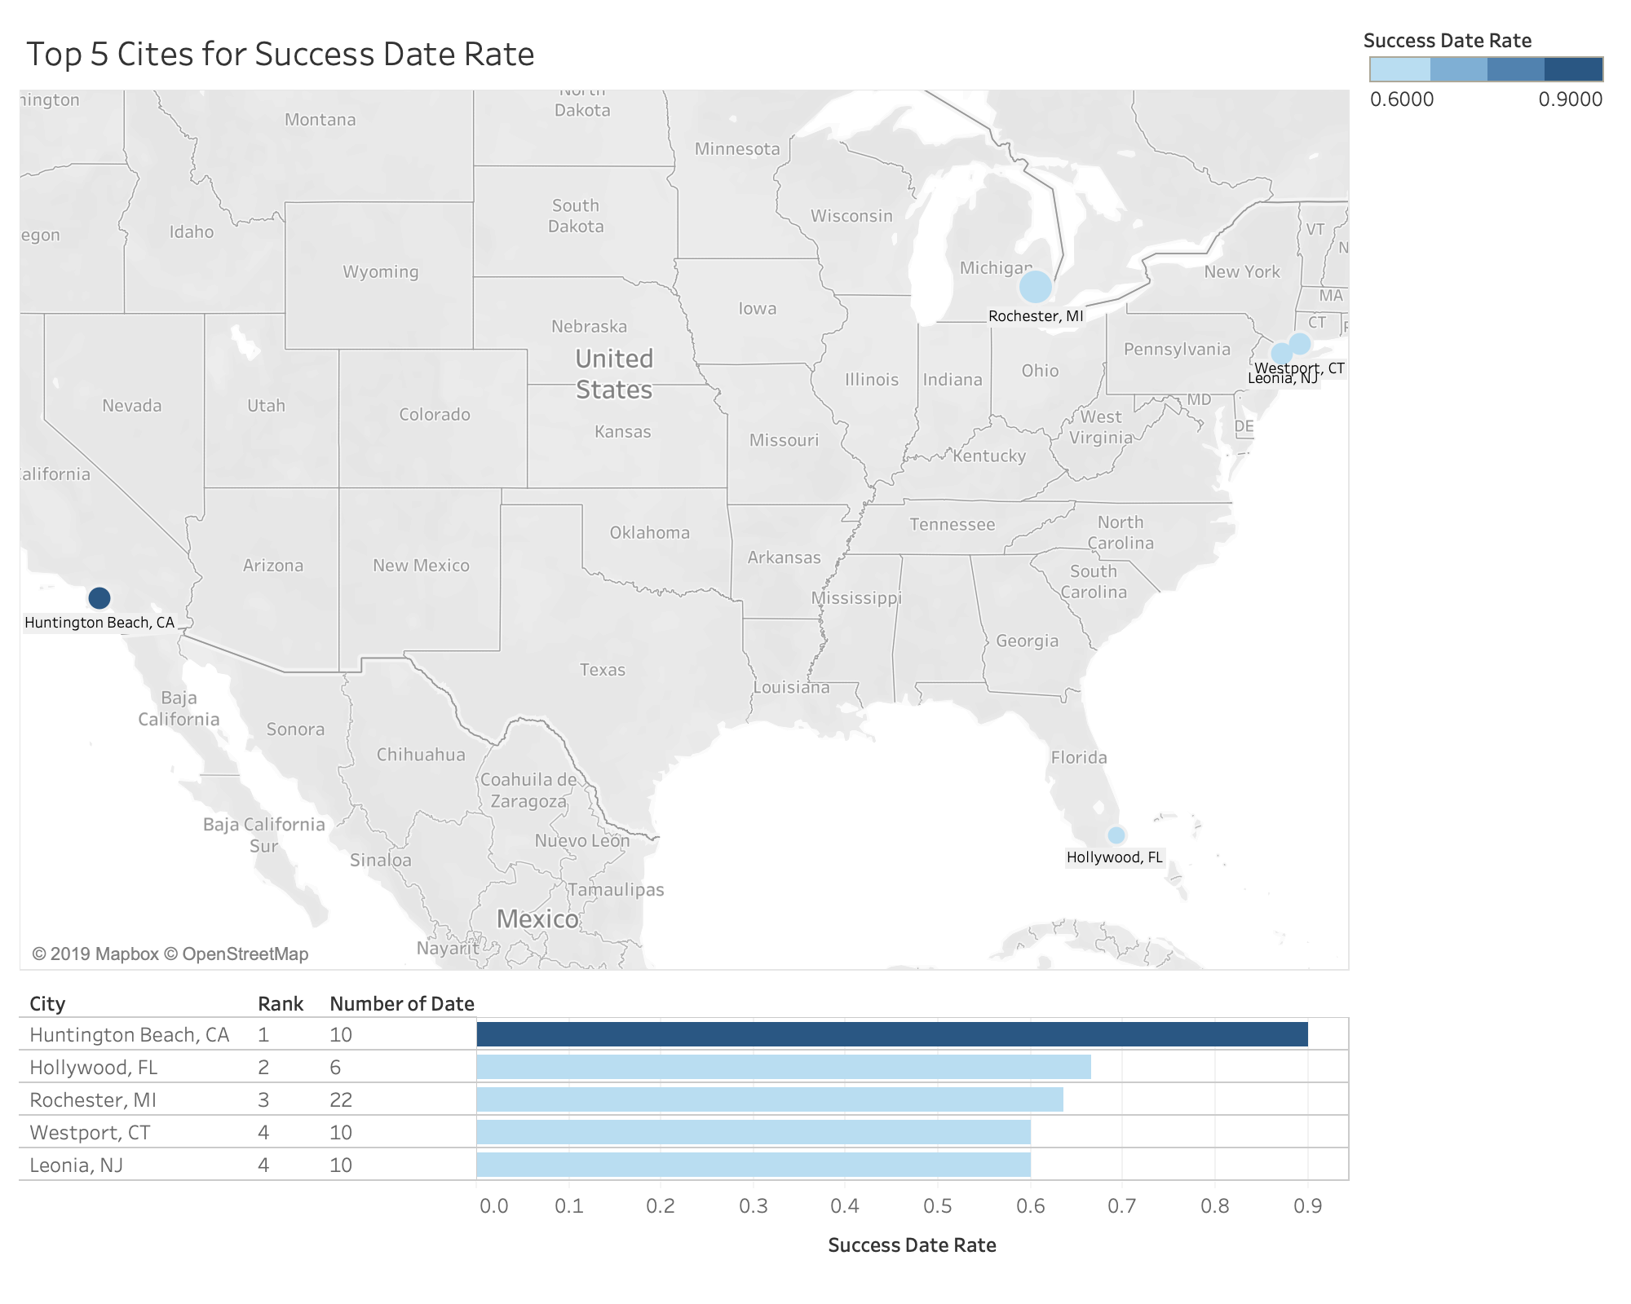
Geographic Analysis on Successful Dates
Calculate success date rates by the cities they grew up and plot them geographically
The people from Huntington, CA have very high match rate
Among of those 5, the people from Rochester, MI also have pretty high number of date

Slide 6
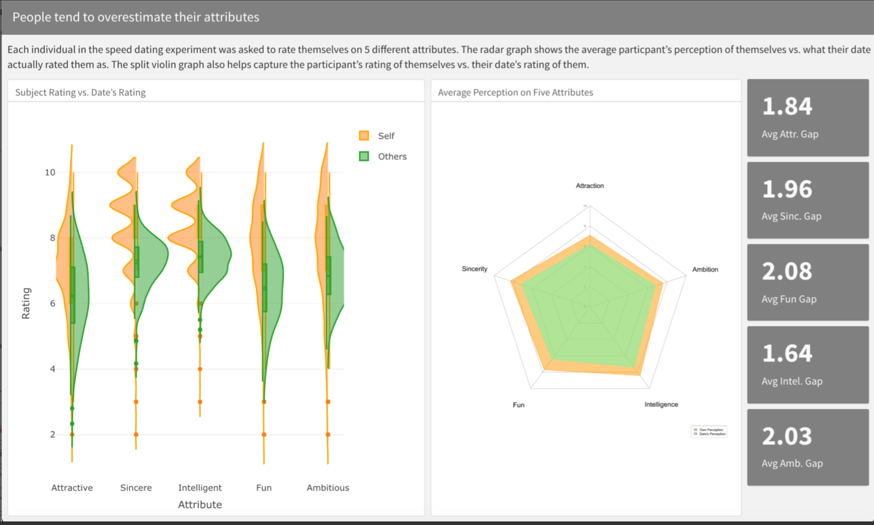
We Overestimate Our Personal Attributes...
Score based on 1-10 rating system
Participant self-score
Date’s score on participant
Participants thought more highly of themselves than what their dates rated them as
People think they’re more fun than they actually are!
http://rpubs.com/izquierdo_jess/550365
Notes:
Each individual involved in the speed dating experiment was asked to rate themselves on a scale from 1-10 on 5 different attributes, they were then rated by their dates on those same attributes.
Overall, we observed that participants thought more highly of themselves than what their dates rated them as. The radar graph on the right shows the average rating for each category - the orange represents the participant and the green represents the date. We see that the orange shading covers more area, meaning participants rated themselves higher than their date rated them on all attributes.
The largest gap was in the Fun attribute- gap of 2.03. People think they’re more fun than they actually are!
Intelligence showed the lowest gap between the average participant score and the date’s score for participant

Slide 7
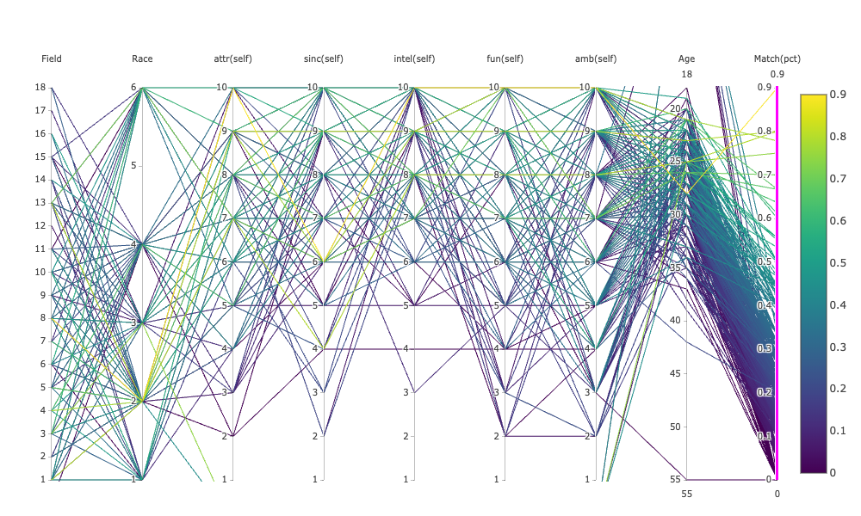
Interesting Patterns of Demographics, Self-perception and Dating Success
Parallel Coordinate Plot
Demographics: field of study, race, age
Self-perception of their attractiveness, sincere, intelligence, fun, ambition
Success Rate (match count/total rounds) - Sequential Color

Slide 8
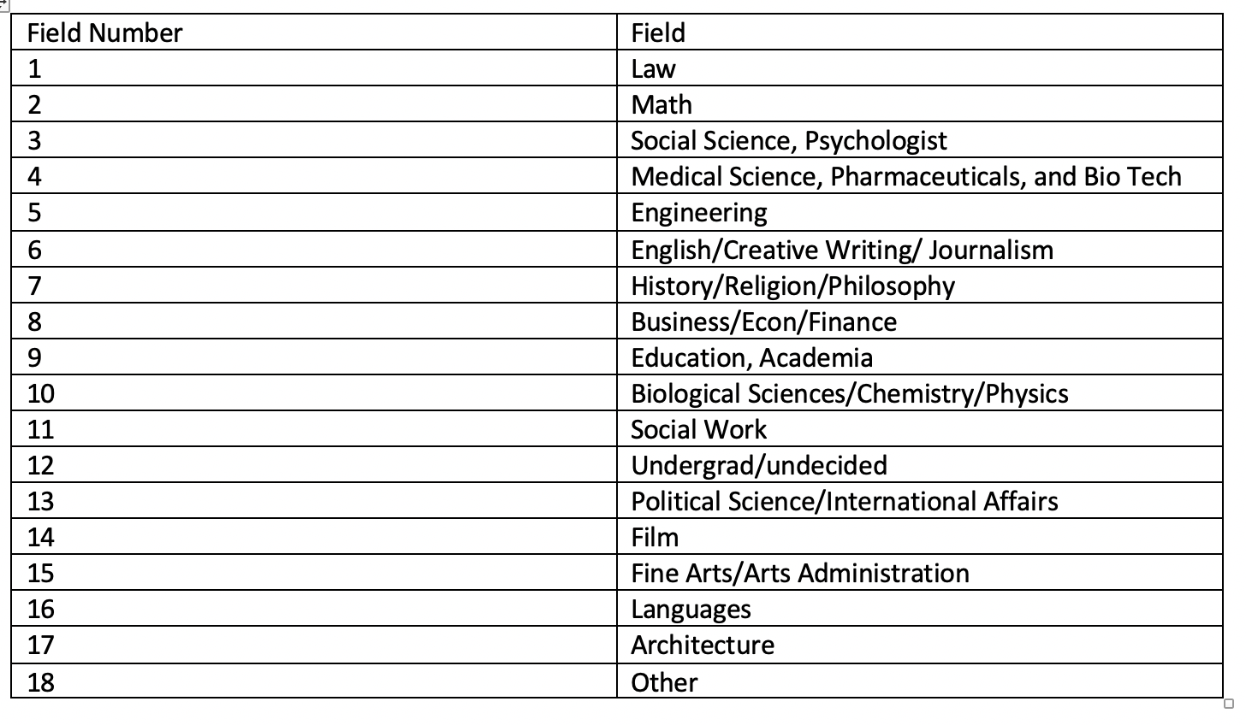
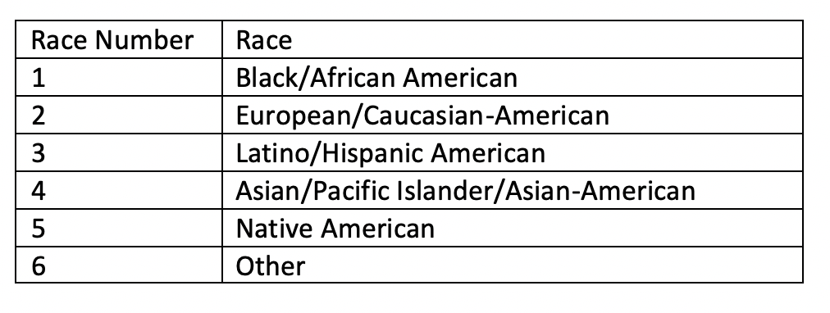
Data Description Tables
Notes:
Using the same graph with high matching rate selected, we can observe that participants who have matching rate over 50% tends to rate themselves high in all 5 attributes. Ambitions and attractiveness might not be as important as intelligence, sincere and fun.

Slide 9
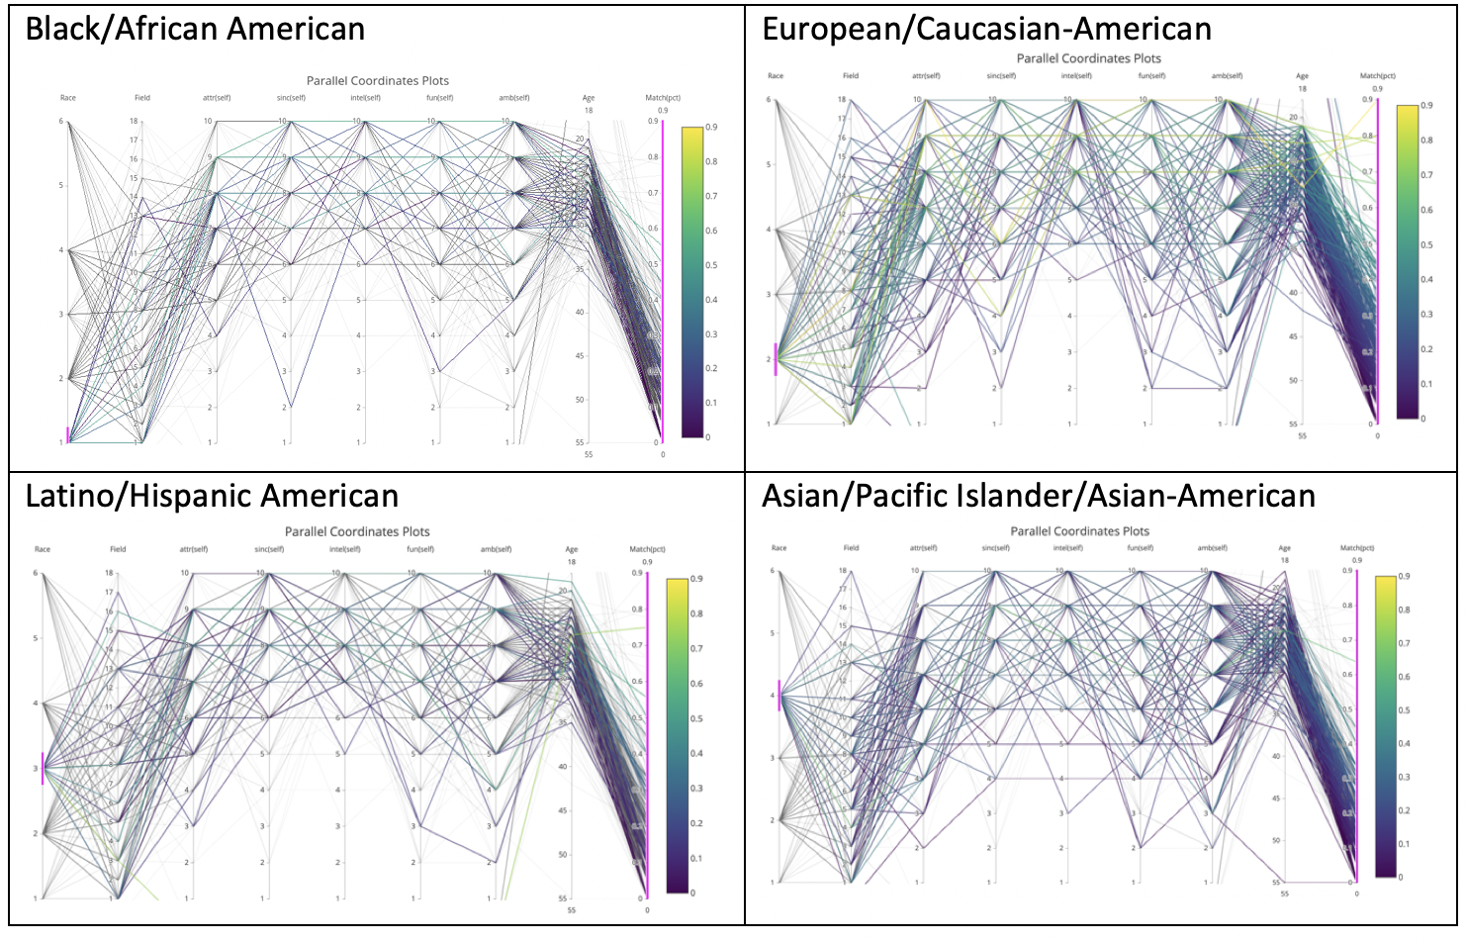
Are people of different races perceiving themselves differently?
People of different races have the most diversities in self-perceived ambitions
Most of the people of different races rate themselves above 5 for intelligence.
Notes:
By pulling ‘race’ to the first vertical line and select different values of this feature, the four graphs show the patterns of 4 different races. In terms of the general trend of different attributes, there are similarities among different races. For example, people of different races have the most diversities in self-perceived ambitions while most of the people of different races rate themselves above 5 for intelligence.

Slide 10
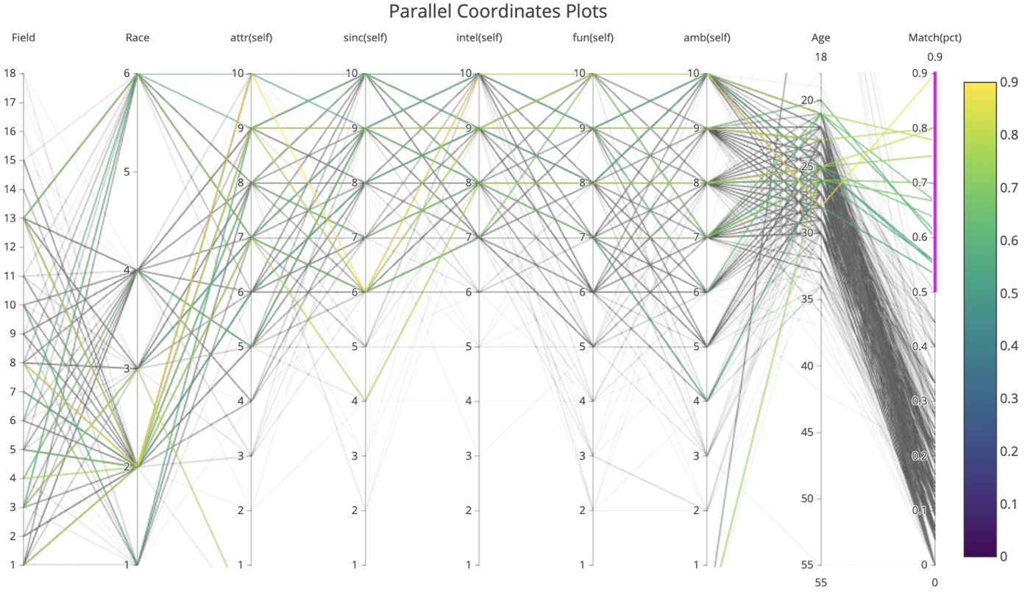
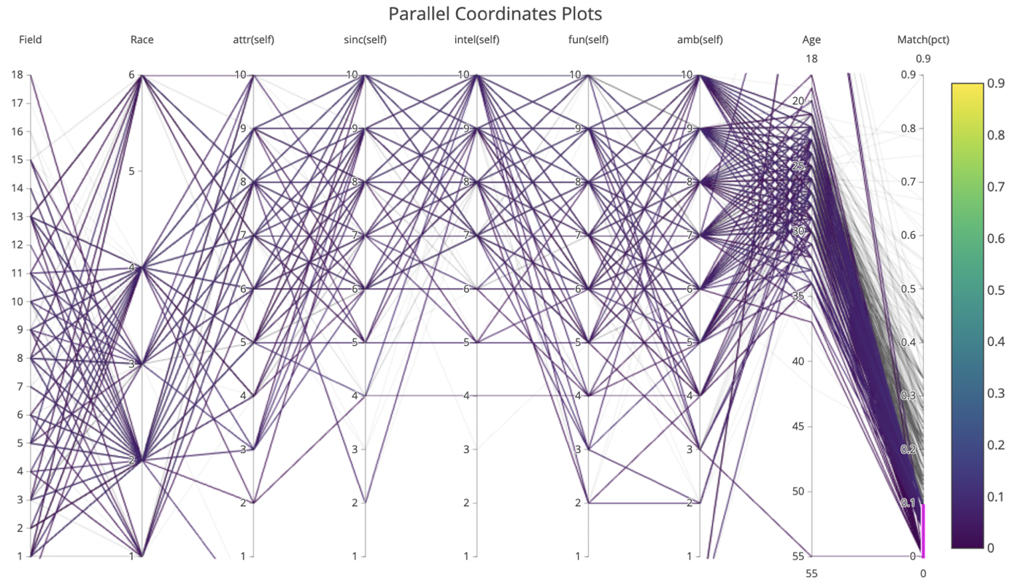
Are people from certain field of study more successful in dating?
Notes:
By pulling field to the first vertical line and selecting matching percent over 50%, the graph shows that participants of field of study from 1 to 13 all have high matching percent. The participant with 90% matching rate studies business/econ/finance. Participants with over 80% matching rates also study Political Science/International Affairs and Law. People who are good at communication might win themselves a date.

Slide 11
Are people who have a high self-perception for different attributes more successful in dating?
Notes:
Using the same graph with high matching rate selected, we can observe that participants who have matching rate over 50% tends to rate themselves high in all 5 attributes. Ambitions and attractiveness might not be as important as intelligence, sincere and fun.

Slide 12

Q & A
Thanks!

